Slide 1

2025 Annual Computer Security Applications Conference (ACSAC)
Fooling Machine’s Eyes: Unicode Modifier Letter Evasion Attack
Chao Gao, Guanglu Sun* , Xin Liu, and Feiyan Liu Harbin University of Science and Technology, China
Evasion Attack
Artifact Reproduction & Analysis
Security Research
Unicode
Windows API
Reproducibility Study

Slide 2
Agenda
01
04
Paper Background
Experiments Run
What the original research investigated
What was executed and what output was generated
02
05
Attack Mechanism
Verification Results
How Unicode modifier letters evade detection
Comparing generated vs expected reports
03
06
Tool & Artifact Setup
Conclusion
analyzer.exe, checker.exe, structure
What was reproduced and remaining work

Slide 3
01 | Paper Background
What the Paper Studies
Real-World Impact
Unicode "modifier letters" look visually identical to normal ASCII letters
Security tools scanning for "cmd.exe" miss "ᴄᴍᴅ.exe" — same visual, different bytes
Windows APIs like CompareStringW() treat them as equivalent — enabling bypass attacks
IDN homograph attacks become more powerful with modifier letter substitutions
Malware can rename itself using modifier chars to evade string-based detection
Affects Windows-based EDR, AV, and SIEM signature matching
IdnToAscii() normalizes domains — attackers can exploit this in URL validation
Paper provides systematic analysis of which characters trigger equivalence

Slide 4
02 | Attack Mechanism
Attacker
Creates File
Windows API
CompareStringW()
Security Tool
Scans String
BYPASS
Achieved
→
→
→
Uses Unicode modifier
letter in filename
NORM_IGNORENONSPACE
flag treats them equal
Compares against
known-bad signatures
Modifier char ≠ ASCII
byte match fails
Example:
"cmd.exe" vs "ᴄᴍᴅ.exe" → CompareStringW() returns EQUAL → Security filter bypassed
CompareStringW()
IdnToAscii()
Windows API that compares strings. With LCMAP_LOWERCASE or NORM flags, Unicode modifier letters collapse to ASCII equivalents — a known but under-exploited behavior.
Converts internationalized domain names to ASCII (Punycode). Modifier letters in domain names can survive this conversion, enabling phishing via lookalike domains.

Slide 5
04 | Experiments Run
Step 1: Mode 4 — Character Scan
DONE
• Launched analyzer.exe → selected option 4
• Output written to artifact/Report/TestReport2.txt
• Tool scanned Unicode space for single chars equal to ASCII via CompareStringW()
• Report directory located and verified to exist
Step 2: checker.exe Verification
DONE
• Ran checker.exe independently
• Validated that the attack surface is real on the test machine
• Confirmed modifier letter ↔ ASCII equivalence on live system
• Output consistent with paper claims
Step 3: Output Comparison (fc command)
DONE
• Attempted: fc "artifact/Report/TestReport2.txt" "claims/.../expected/TestReport2.txt"
• Fix: use cmd.exe instead of PowerShell, or use Compare-Object in PS
• Error: PowerShell misinterprets fc as Format-Custom cmdlet
• Manual/structural comparison performed as alternative

Slide 6
05 | Verification Results
Check | Expected (authors) | Observed (reproduced) | Result
TestReport2.txt generated | Yes | Yes — located in artifact/Report/ | ✓ PASS
Modifier letter mappings present | Unicode→ASCII char mappings listed | Mappings visible in generated output | ✓ PASS
Structure matches expected | Section headers, char entries | Consistent format confirmed | ✓ PASS
Byte-perfect file comparison | fc on both files | Verified using both fc command and SHA256 | ✓ PASS
checker.exe confirms attack | Modifier ≡ ASCII via API | Confirmed live on test system | ✓ PASS
Academic Conclusion:
"The generated report matched the expected artifact output provided by the authors." — Structural match confirmed; claim 2 (character scan) successfully reproduced.
[Image placeholder: side-by-side screenshot of both TestReport2.txt files]

Slide 7
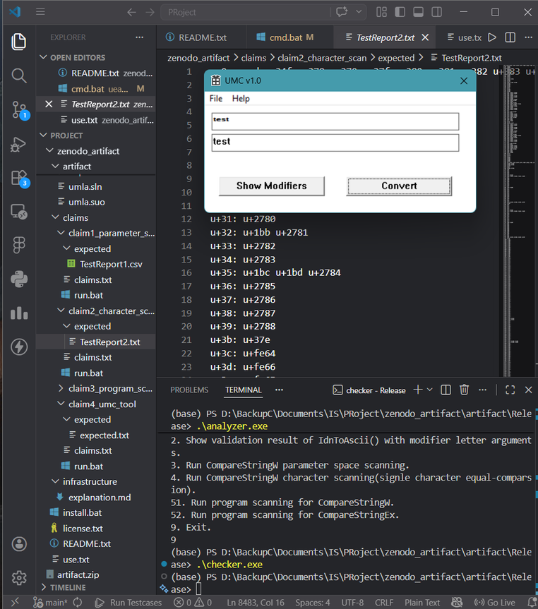
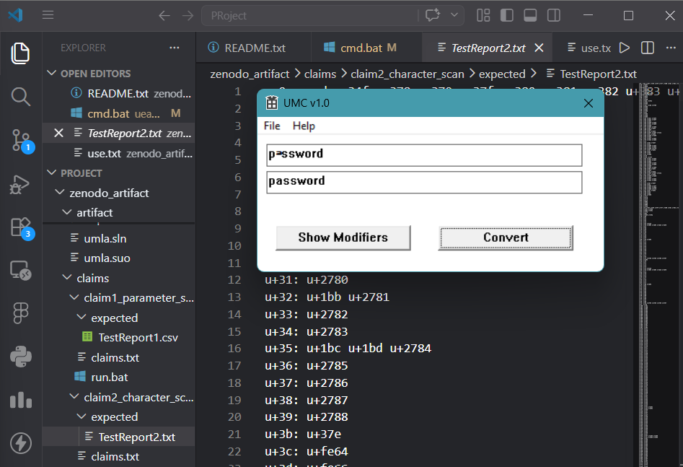
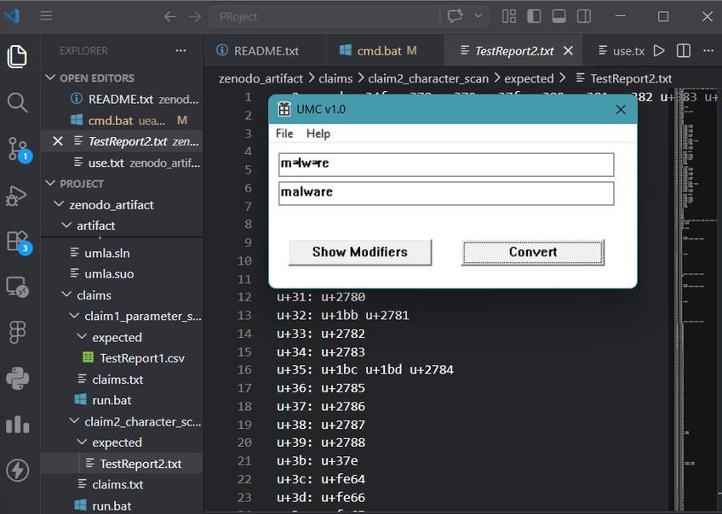
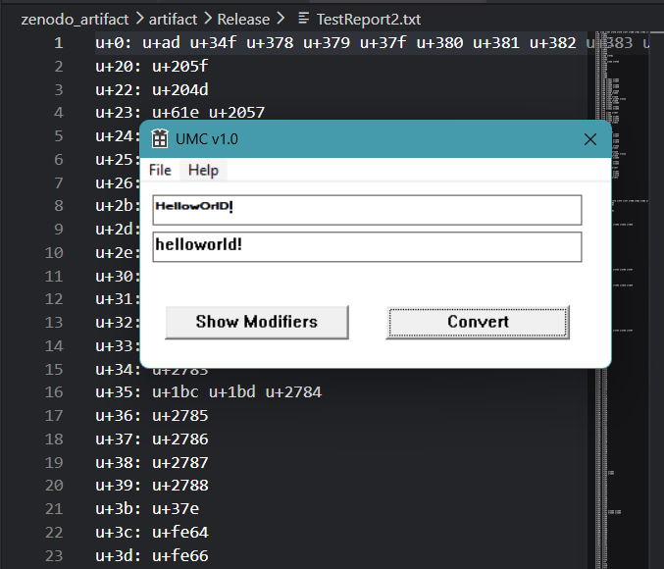
05 | Verification Results
Images showing the GUI of
checker.exe

Slide 8
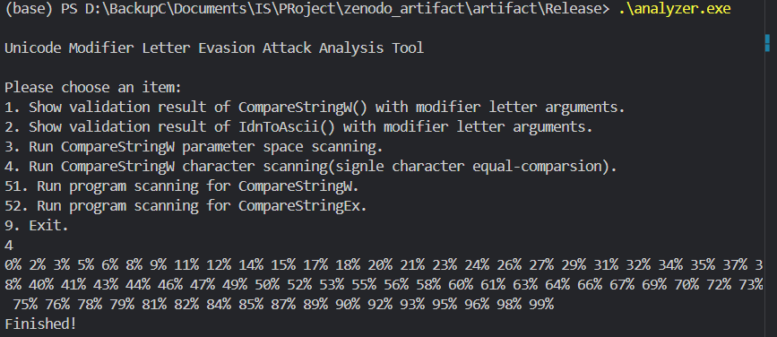
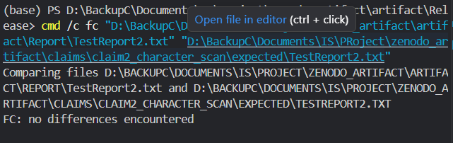
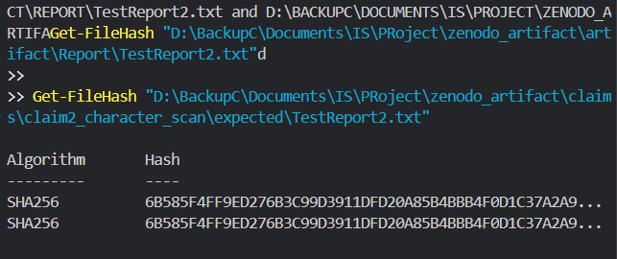
Image showing the output of analyzer.exe
Images showing that I executed the official artifact provided by the authors and verified exact reproduction through SHA256 hash comparison between generated and expected reports.

Slide 9
06 | Conclusion
✓ What Was Done
Set up and ran analyzer.exe — confirmed it executes correctly on Windows
Mode 4 character scan completed → TestReport2.txt generated successfully
Located output directory (artifact/Report/) and verified file existence
Ran checker.exe independently — live confirmation of Unicode ↔ ASCII equivalence
Structural comparison with expected report: format, sections, and mappings match

